Slide 1
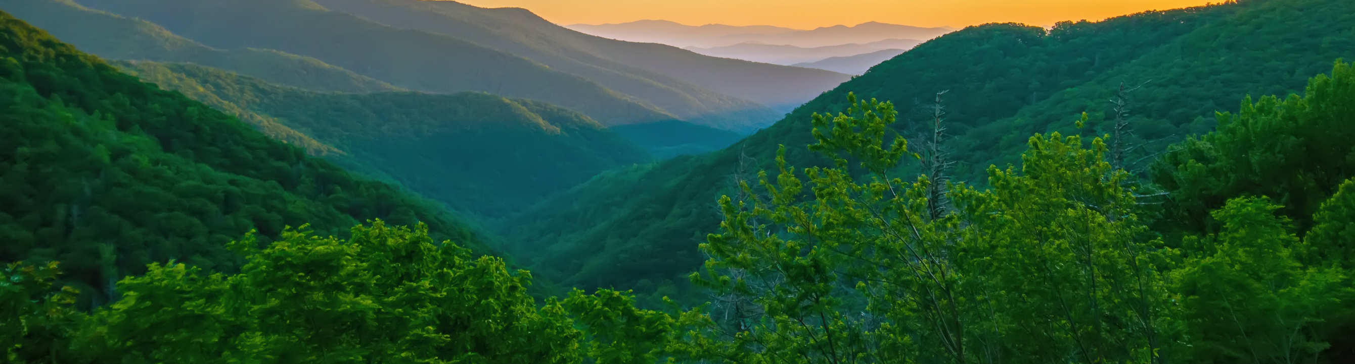

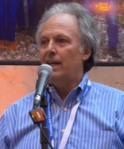
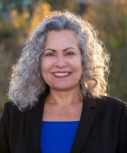
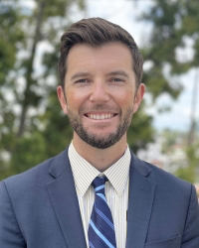
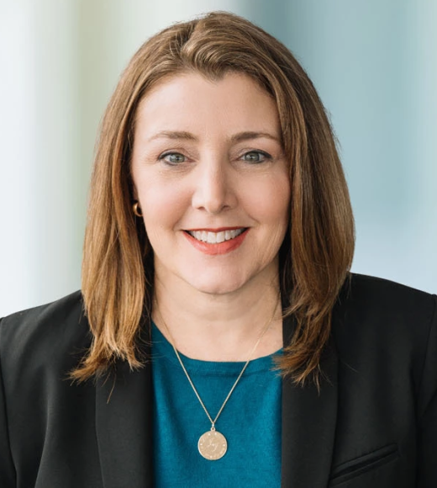
MEET YOUR ENVIROBOARD
California Environmental Law and Policy Center
COREY BROWN '82
TINA CANNON LEAHY '98
MILES HOGAN '12
JENNIFER L. SPALETTA '98
RESOURCES LEGACY FUND
CITY OF VENTURA, VENTURA, CA
STATE WATER RESOURCES CONTROL BOARD
STOEL RIVES LLP

Slide 2
CONTACT INFORMATION
California Environmental Law and Policy Center
COREY BROWN '82
TINA CANNON LEAHY '98
MILES HOGAN '12
JENNIFER L. SPALETTA '98
CIBROWNCI@ICLOUD.COM
MHOGAN@CITYOFVENTURA.CA.GOV
TCLEAHY@UCDAVIS.EDU
JENNIFER.SPALETTA@STOEL.COM

